Slide 1


BANKCRUPTCY PREVENTION PROJECT

Slide 2
Table Of Contents:
Project architecture
Problem Statement
Business objective
Data Preprocessing
Visualization
Feature Selection
Model Selection
Deployment

Slide 3
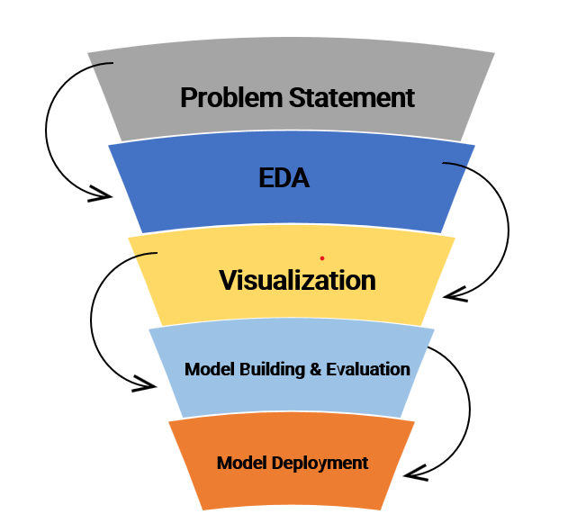
Project architecture

Slide 4

Problem Statement
To develop a machine learning model that accurately predicts whether a company is at risk of bankruptcy based on key financial and business indicators.

Slide 5

Business objective
Enable stakeholders (investors, creditors, and management) to identify high-risk companies early, make informed decisions, and mitigate financial losses.

Slide 6

Data Preprocessing:
Dataset contains 259 rows and 7 columns.
>>Independent Variable, X=6 Features
>> Dependent Variable, y = class
No Null Values.
Duplicates: 250 >> 103.
LabelEncoding : “Bankruptcy:0”, “Non-Bankruptcy:1”.
Standarization of data is done.

Slide 7
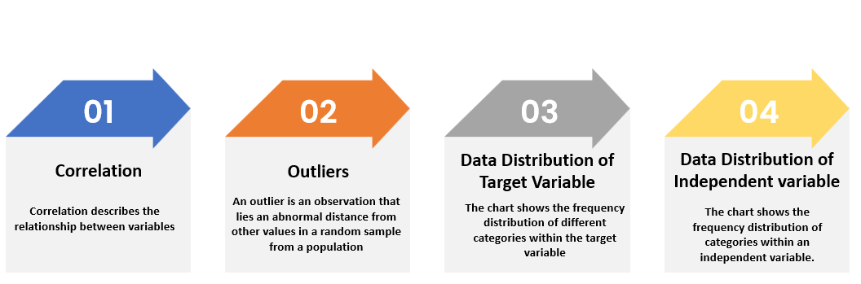
Visualization

Slide 8
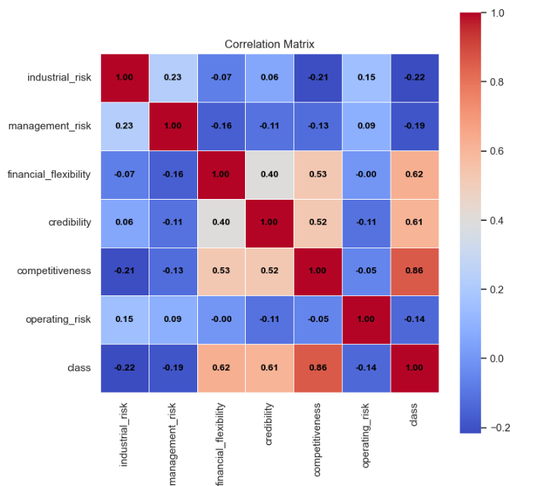
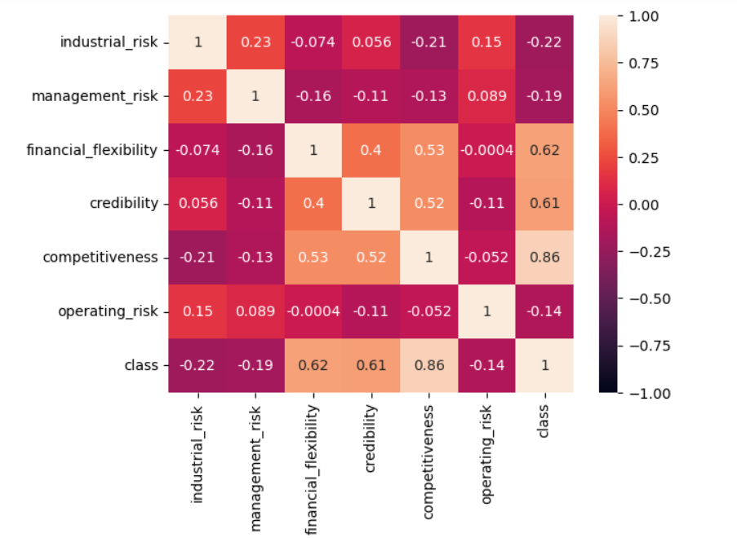
Correlation Matrix
It helps in understanding the relation between to particular variables.
From this we could understand that there are positive and negative relation.
Based on these analysis we can perform feature selection.

Slide 9
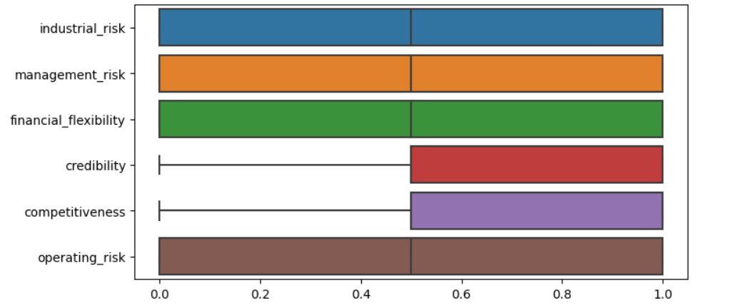
Box Plot For Outliers
As the data is distributed among the values 0.0,0.5 and 1.0 there are no outliers and this is the visual representation for that

Slide 10
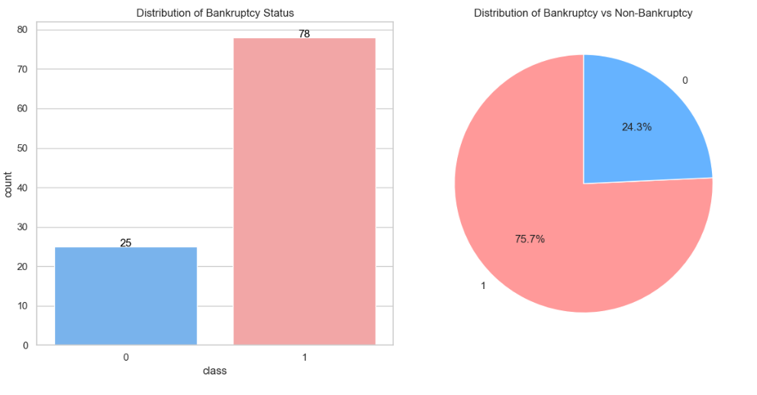
Data Distribution of class variable

Slide 11
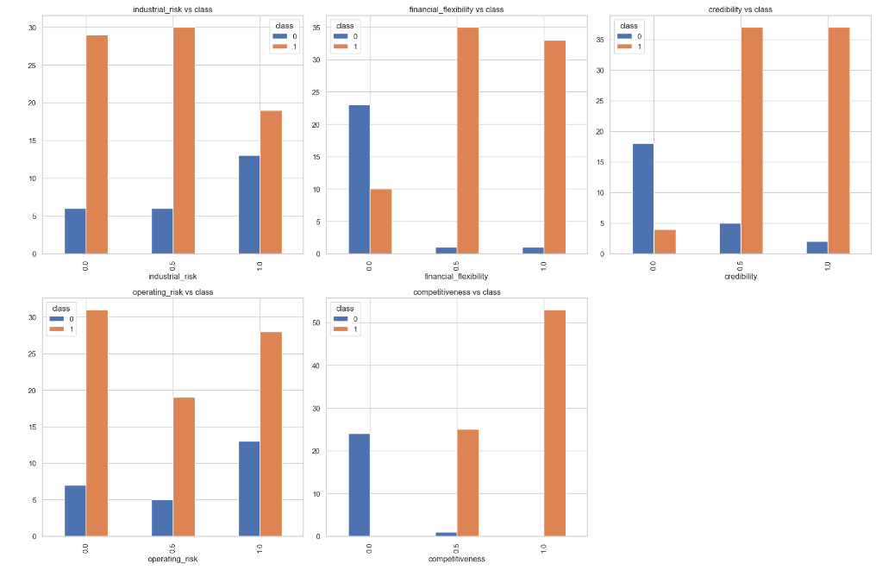
Data Distribution with class variable
From this we can understand the relation between x variables and y variable.
It represents that when the value of x variable increases there is change in the distribution of y variable.

Slide 12
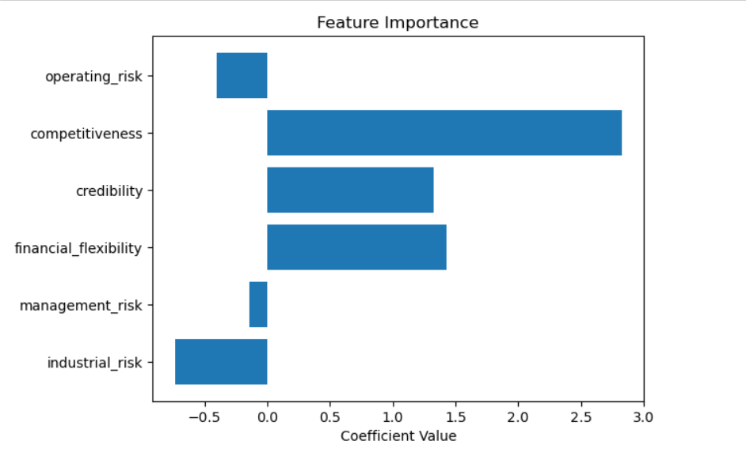
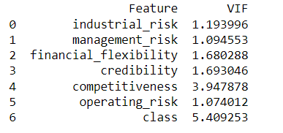
Feature Selection

Slide 13
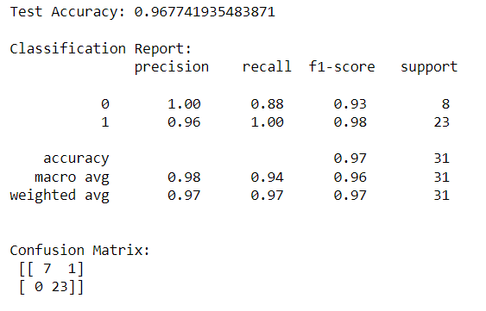
Model Selection
Hyper Parameter Tuning>>>>>>
Based on result we decided that the model should perform in such a way that the accuracy must be more than or equal to 96%, and the main consideration is confusion matrix.

Slide 14
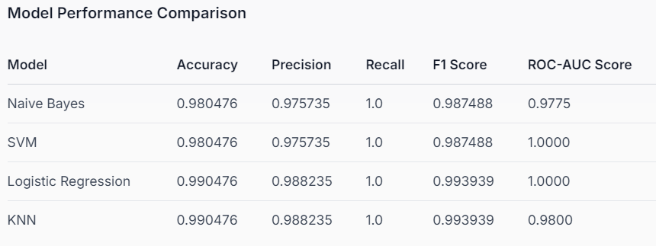
Model Selection

Slide 15
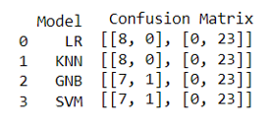

Model Selection
>> From the hyperparameter our main preference was confusion matrix also.
>>As every model reach our requirements, we selected model which performed well than other models.
>>So, our primary decision was to choose either logistic regression or knn model.

Slide 16
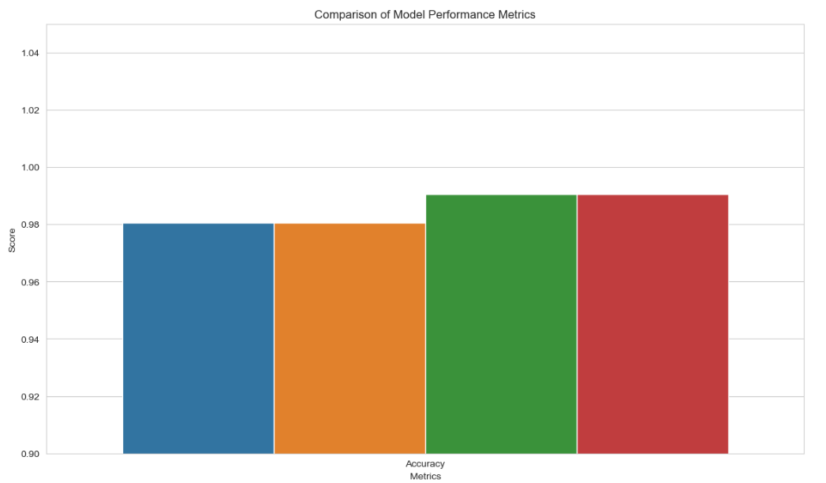
Conclusion
Our final conclusion is K- Nearest Neighbour Model.
For logistic there is a chance of getting effected because of outliers.
For continuous response variable KNN is better.
Knn is less sensitive for outliers.
Fast and effective for complex datasets also.

Slide 17
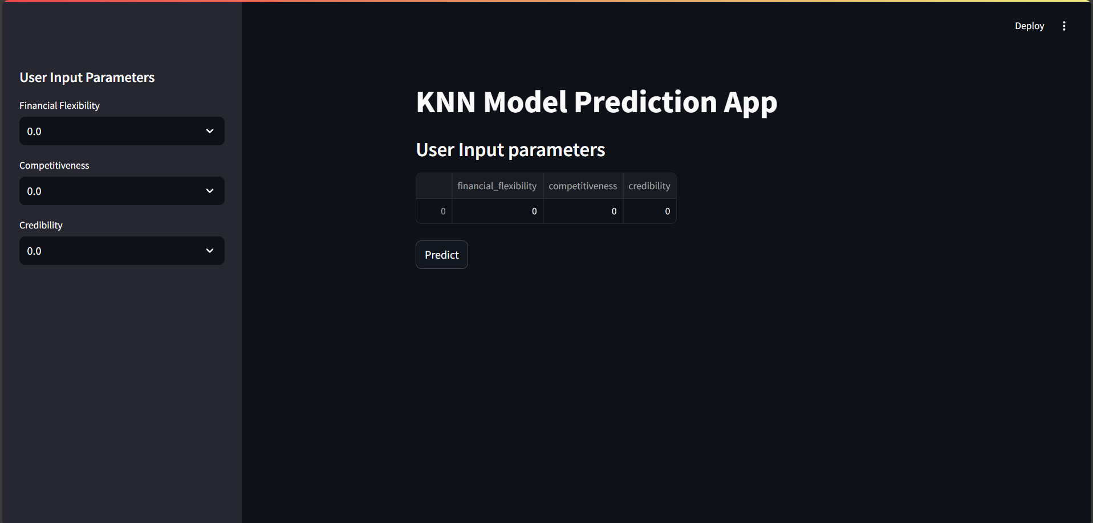
Deployment

Slide 18
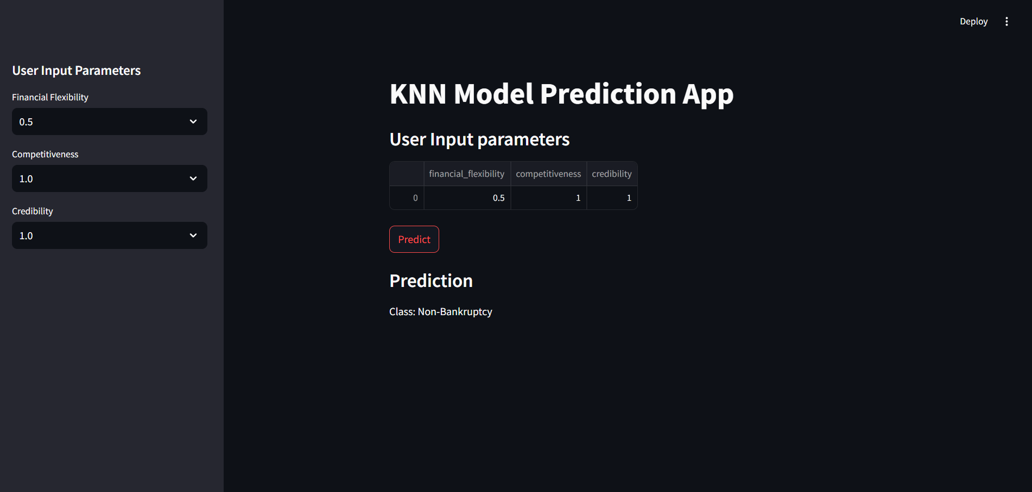

Slide 19

Our Team:
Samiksha S. Janjirkar Bharad Archana Vilas Veena Kandalam P Raghavendra Aarzoo fatima khan Nagella Naga Prasanna Shaik Abdul Raheem

Slide 20


